Slide 1
Start/Finish PlaceHolder
5 Seconds Each (each slide 10 seconds)

Slide 2
Background
Data Structures can be abused via predictability
Distributed Denial of Service Attacks (DDOS)
Algorithmic DOS
Predictable Timings

Slide 3
Background Cont.
Goal is to create a Data Structure that can’t be DOS’d
Adaptability
Running time must be reasonable.
Assume the Attacker knows the data structure and has unlimited function calls..

Slide 4
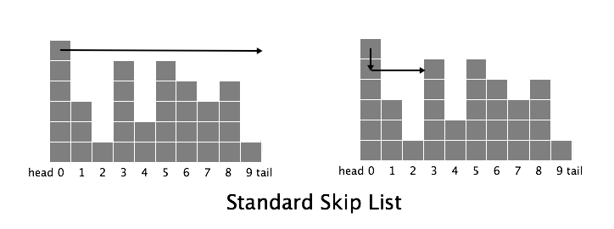
What is our Data Structure
The structure chosen must enable insertion, deletion, and searching.
Basic Level Link Lists
Skip Lists

Slide 5
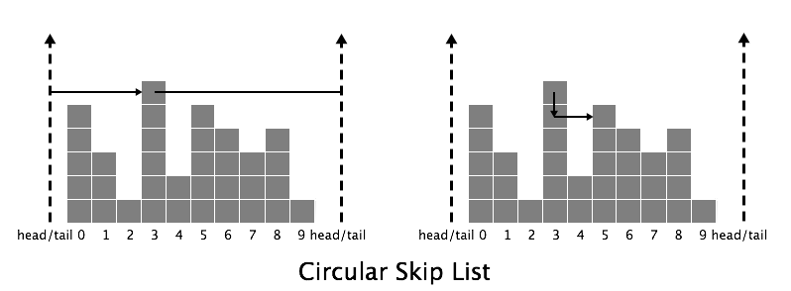
What is our Data Structure 2
Circular Skip Lists
Choosing an Origin
Randomizing Origin

Slide 6
Benefits
Retains Efficiency
Untrackable Probability Distribution
Unpredictable even under attack.

Slide 7
List of Operations
Insertion
Deletion
Search
Change Height
Change Origin

Slide 8
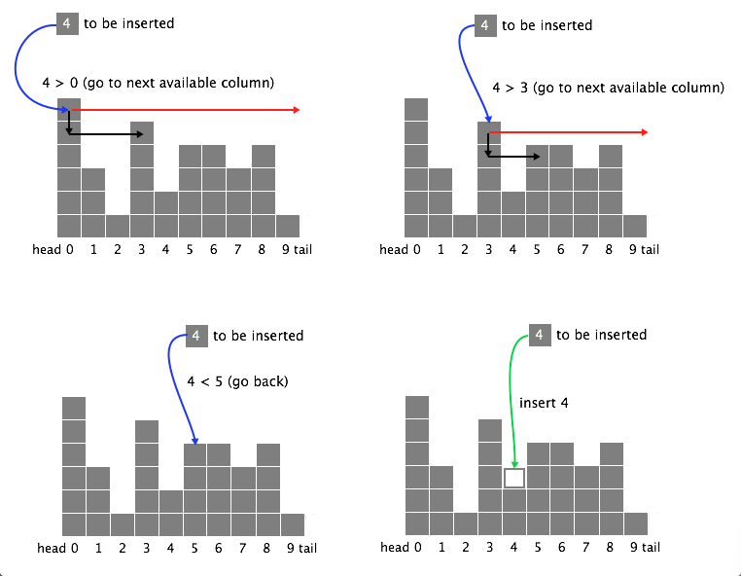
Insertion

Slide 9
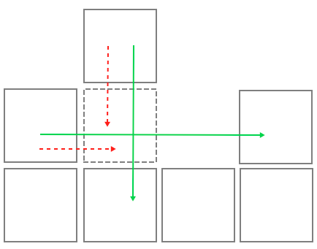
Deletion

Slide 10
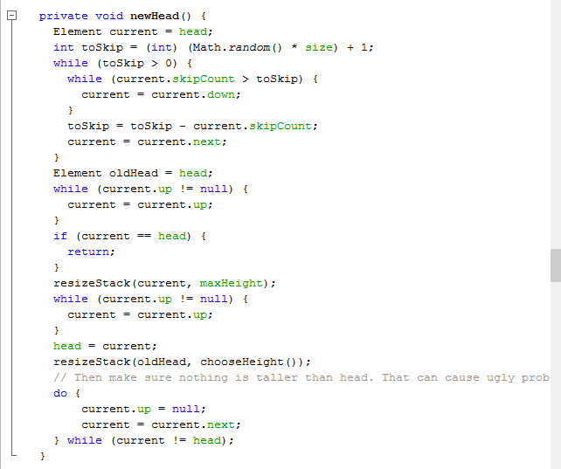
Change Origen

Slide 11
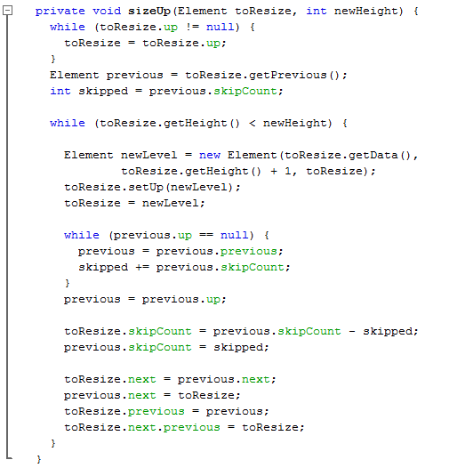
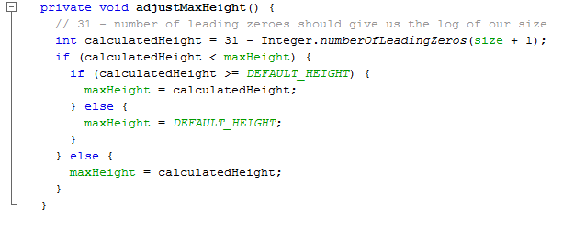
Change Height

Slide 12
Large Scale Visualization
“And after 60,000 additions it looks like this “
Insert sweet picture.

Slide 13
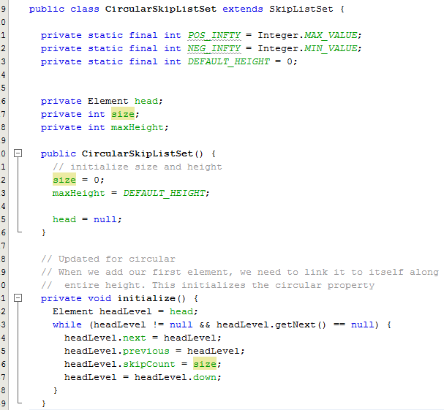
We Programmed It!

Slide 14
Results General
Costs and Benefits of randomized structure in a real example.
Actual Data vs. Theoretical Benefits.
Programming to help Understanding
Results shown via Graphs

Slide 15
Cost of Circular Operations, No Attacker
Unexpected Results for Small Data Sets
Larger Sets with faster searches.
Random Variation + Implementation quirks
Circular 3x Slower under normal operations with no attacker

Slide 16
Benefits of Circular, with Attacker
Timing benefits grow as size of data set grows
Worse than theoretical time but reasonable
Hundreds or even thousands of time faster when under attack.

Slide 17
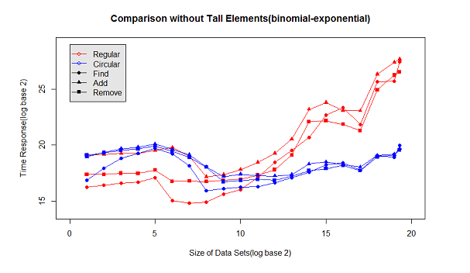
Results

Slide 18
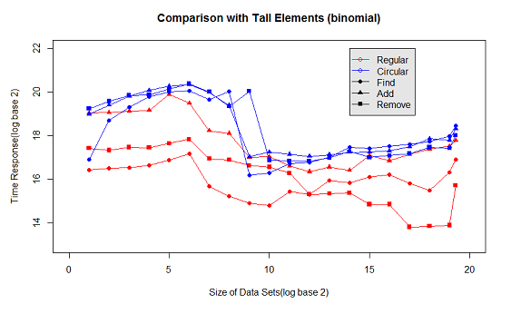
Results Cont.

Slide 19
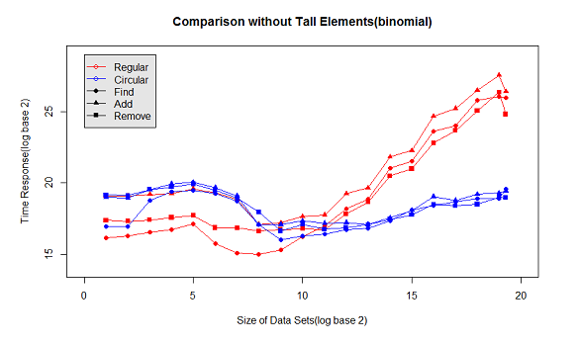
Results Cont.

Slide 20
Our Algorithm vs. Proposed algorithm
Different Searching Methods for simplicity
Tracking by offset rather than indexing
Origen as element instead of constant value
Slight differences in Resizing methods

Slide 21
Frustrations with Implementation
Keeping track of offset through operations
Keeping track of the origin
Resizing in an efficient manner
Transferring methods from standard skip list to circular skip list.

Slide 22
What we wanted to do, but didn’t
Random normal skip lists.
Analyze timing of Random Circular vs Random Normal
Bring our implementation closer to theoretical implementation in paper.

Slide 23
Further Research on Subject
Testing similar implementation methods with other data structures, for example a Binary tree.
Finding new implementation methods that can help with timing unpredictability.
Exploring real life applications for the concept.

Slide 24
Summary
Similar to a linked list.
More secure against DOS attacks.

